Slide 1
Compute Infrastructure
Fazal M Raza
Azure Technology Specialist

Slide 2
CERTIFICATION
Key links
aka.ms/70-535
aka.ms/Ignite/70-534
aka.ms/Azure/Learn
aka.ms/Azure/Architectures

Slide 3
How to prepare and take the Exam
What to buy or use to study with
Almost everything written that you need can be found at azure.microsoft.com
Get a Free trial account.
Ignite Hands-On Workshops/Labs
Microsoft Virtual Academy (MVA)
When doing a Prep Exam
Select all of the questions for a particular topic, then click END. Review all the answers right and wrong
Before you Press Start
Have a mental cheat sheet
Right before you start – DUMP IT on the paper they give you for notes
Then when you START ..Try to answer the Case Study Questions first, BEFORE reading the Case Study!

Slide 4
How to prepare and take the Exam
What to buy or use to study with
Almost everything written that you need can be found at azure.microsoft.com
Get a Free trial account.
Ignite Hands-On Workshops/Labs
Microsoft Virtual Academy (MVA)
When doing a Prep Exam
Select all of the questions for a particular topic, then click END. Review all the answers right and wrong
Before you Press Start
Have a mental cheat sheet
Right before you start – DUMP IT on the paper they give you for notes
Then when you START ..Try to answer the Case Study Questions first, BEFORE reading the Case Study!

Slide 5
CAVEAT EMPTOR!!!!!!!
The following 6 slides are NOT everything for exam topics
The focus is on what is new with 70-535 versus 70-534
You MUST review aka.ms/70-535 for ALL of the objectives
AND if you are familiar with the older topics = Good
If you are not, then ALSO watch aka.ms/Ignite/70-534

Slide 6
Design Compute Infrastructure
70-535 Compute Infrastructure Objectives | Compute Infrastructure New Topics
Design using Virtual Machines | Using Web App for Containers. Design VM Scale Sets, define a migration strategy from cloud services
Design for Serverless computing | Design for serverless computing using Azure Container Instances
Design microservices-based solutions | Choose between container-based solutions, if orchestration is needed, which platform for container orchestration, when service fabric is appropriate
Design Web Applications | Determine when to use Web Apps on Linux; determine when to use a CDN; determine when to use a cache, including Azure Redis cache
Create compute-intensive application | Same as 70-534

Slide 7
Design Data Implementation
70-535 Data Implementation Objectives | Design Data Implementation New Topics
Design Azure Storage Solutions | When to use blob tiers, disks and StorSimple
Design for Azure Data Services | When to use Data Catalog, Azure Data Factory, SQL Data Warehouse, Azure Data Lake Analytics, Azure Analysis Services, and Azure HDInsight
Design for relational database storage | Determine when to use Azure SQL Database and SQL Server Stretch Database; design for scalability and features; determine when to use Azure Database for MySQL and Azure Database for PostgreSQL; design for HA/DR, geo-replication; design a backup and recovery strategy
Design for NoSQL storage | When to use Azure Redis Cache, Azure Table Storage, Azure Data Lake, Azure Search, Time Series Insights
Design for CosmosDB Storage | When to use MongoDB API, DocumentDB API, Graph API, Azure Tables API; design for cost, performance, data consistency, availability, and business continuity

Slide 8
Design Networking Implementation
70-535 Networking Objectives – new in blue | Networking Topics
Design Azure Virtual Networks | Multi-Node Application Gateways
External Connectivity for Virtual Networks | Virtual Network Peering Architecture & Design
Design security strategies | When to use a Web Application Firewall When to use a Network Virtual Appliance Virtual Network Service Tunneling
Design connectivity for hybrid apps | Azure Relay Service Azure Data Management for Data Factory Azure On-Premises Data Gateway Azure Web-Apps VPN capability Constraints for connectivity with VPN Options for joining VMs to Domain

Slide 9
Design Security & Identity Solutions
70-535 Security & Identity Objectives | New Security & Identity Topics
Design Identity Solution | Design MFA Solutions When to use Azure AD Domain Services Design security for Mobile Apps using AAD
Secure Resources using Identity Providers | Design Mobile Apps using B2C or B2B
Data Security | When to use Azure Key Vault* protecting ARM Templates, application secrets & managing certificates Design Solutions that use Azure AD Managed Service Identity (MSI)
Governance & Policies | When to use ARM Policies When to use Azure PIM When to use HSM –backed keys*
Manage Security Risks | Azure ID Protection Advanced Threat Protection Endpoint Protection Strategy

Slide 10
Design Solutions by using Platform Services
70-535 Platform Services Objectives | Platform Services New Topics
Design for Artificial Intelligence Solutions | When to use Cognitive Services, Azure Bot Service, Azure Machine Learning, and other categories that fall under cognitive AI
Design for IoT | When to use Stream Analytics, IoT Hubs, Event Hubs, real-time analytics, Time Series Insights, IoT Edge, Notification Hubs, Event Grid, and other categories that fall under IoT
Design messaging solution Architectures | Design for Event Grid, Azure Relay, Azure Functions, and Azure Logic Apps; design a push notification strategy for Mobile Apps, for performance & scale
Design for Media Services | Using video indexer, video API, computer vision API, preview, and other media related services

Slide 11
Design for Operations
70-535 Operations Objectives | Design Operations New Topics
Design application monitoring and alerting strategy | Define solutions for analyzing logs and enabling alerts using Azure Log Analytics, define solutions for analyzing performance metrics and enabling alerts using Azure Monitor
Design platform monitoring and alerting | …using Azure Health, Azure Advisor, and Activity Log; define a monitoring solution for Azure Networks using Log Analytics and Network Watcher service; monitor security with Azure Security Center
Design an operations automation strategy | When to use Chef, Puppet, DSC, Event Grid, and Azure Logic Apps; define a strategy for auto-scaling; define a strategy for enabling periodic processes and tasks

Slide 12
Design Compute Infrastructure (20-25%)
Design solutions using virtual machines
Design VM deployments by leveraging availability sets, fault domains, and update domains in Azure; use web app for containers; design VM Scale Sets; design for compute-intensive tasks using Azure Batch; define a migration strategy from cloud services; recommend use of Azure Backup and Azure Site Recovery
Design solutions for serverless computing
Use Azure Functions to implement event-driven actions; design for serverless computing using Azure Container Instances; design application solutions by using Azure Logic Apps, Azure Functions, or both; determine when to use API management service
Design microservices-based solutions
Determine when a container-based solution is appropriate; determine when container-orchestration is appropriate; determine when Azure Service Fabric (ASF) is appropriate; determine when Azure Functions is appropriate; determine when to use API management service; determine when Web API is appropriate; determine which platform is appropriate for container orchestration; consider migrating existing assets versus cloud native deployment; design lifecycle management strategies
Design web applications
Design Azure App Service Web Apps; design custom web API; secure Web API; design Web Apps for scalability and performance; design for high availability using Azure Web Apps in multiple regions; determine which App service plan to use; design Web Apps for business continuity; determine when to use Azure App Service Environment (ASE); design for API apps; determine when to use API management service; determine when to use Web Apps on Linux; determine when to use a CDN; determine when to use a cache, including Azure Redis cache
Create compute-intensive application
Design high-performance computing (HPC) and other compute-intensive applications using Azure Services; determine when to use Azure Batch; design stateless components to accommodate scale; design lifecycle strategy for Azure Batch
Notes:
https://www.microsoft.com/en-us/learning/exam-70-535.aspx

Slide 13
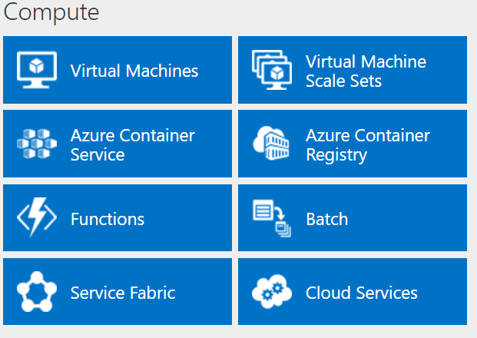
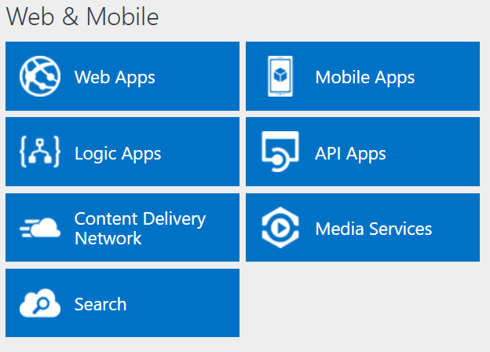
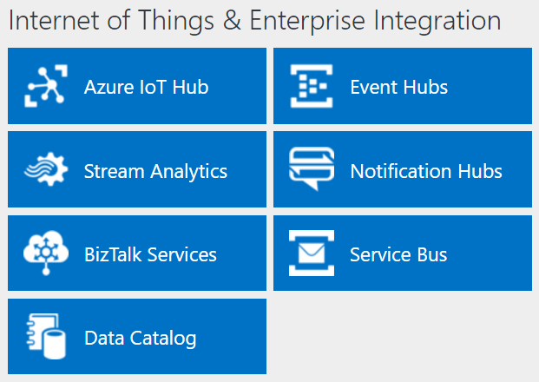
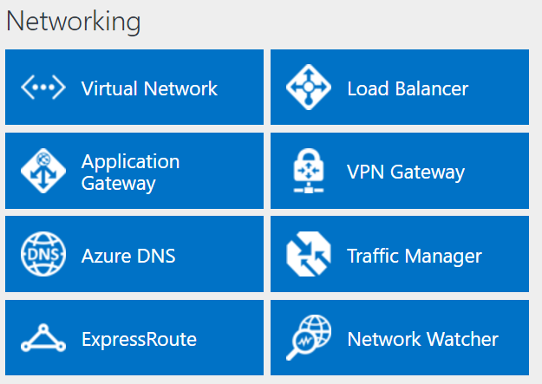
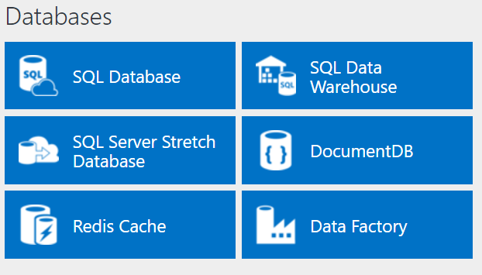
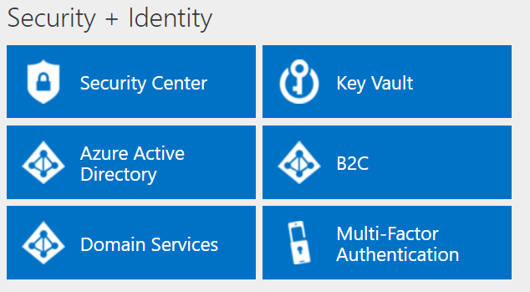
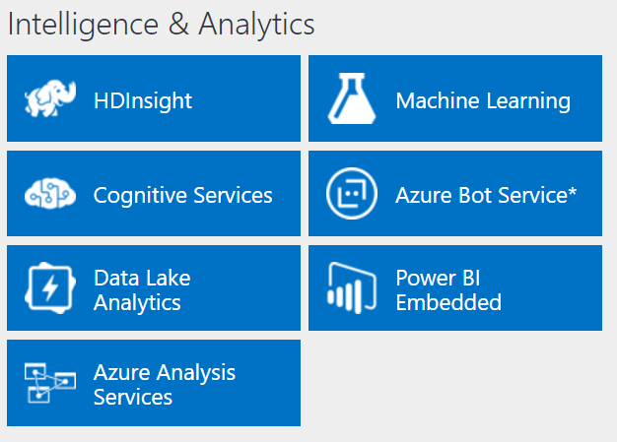
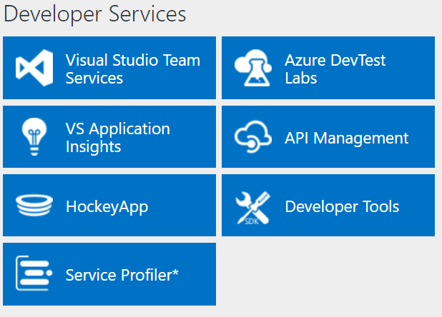
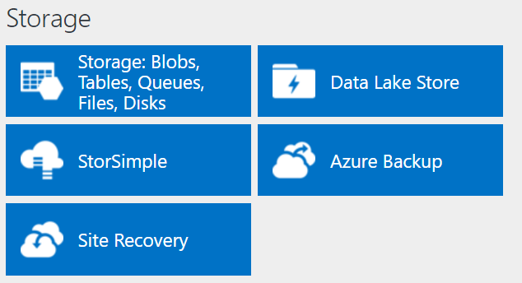
Azure Platform
http://azureplatform.azurewebsites.net/
* Preview Services
Notes:
Preview Version 1.7 (2017-04-20)

Slide 14
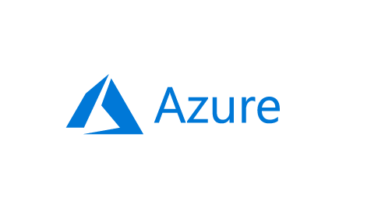
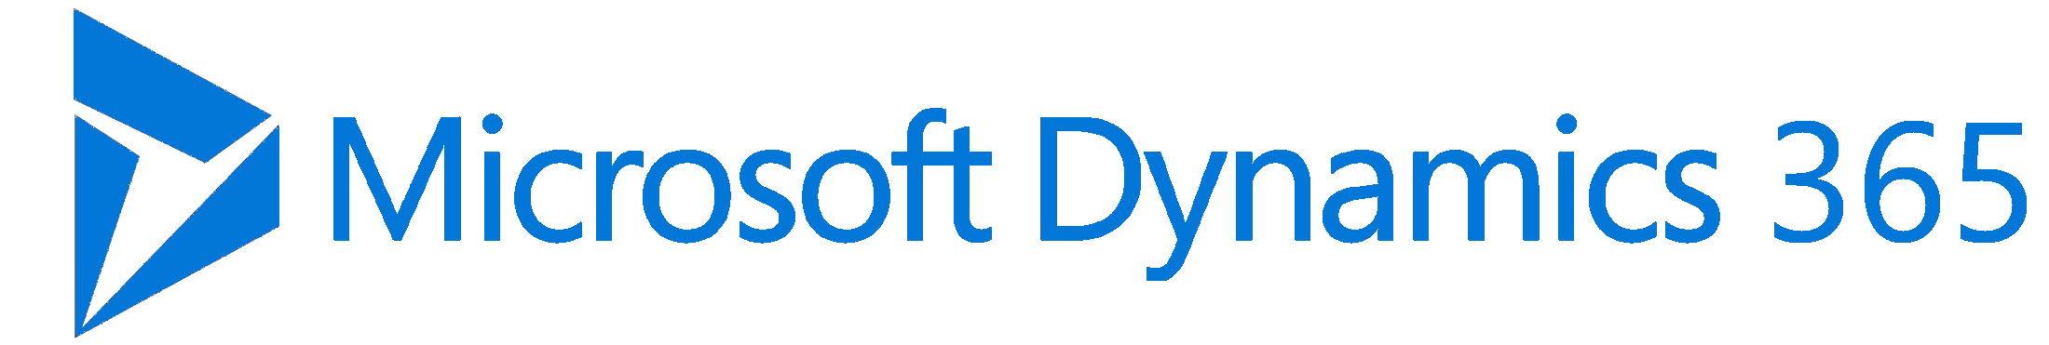
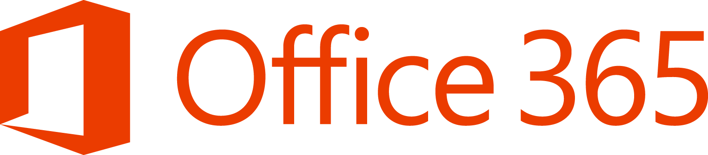

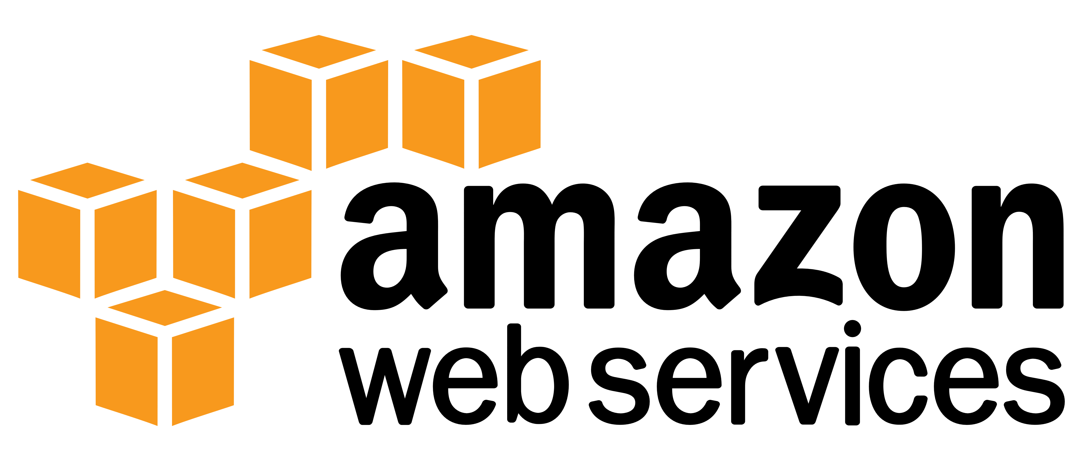



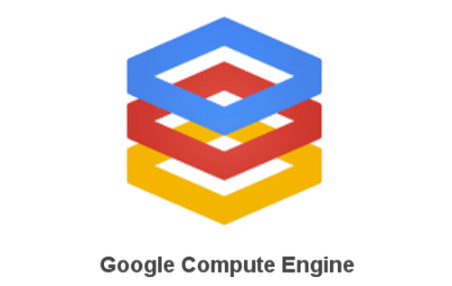
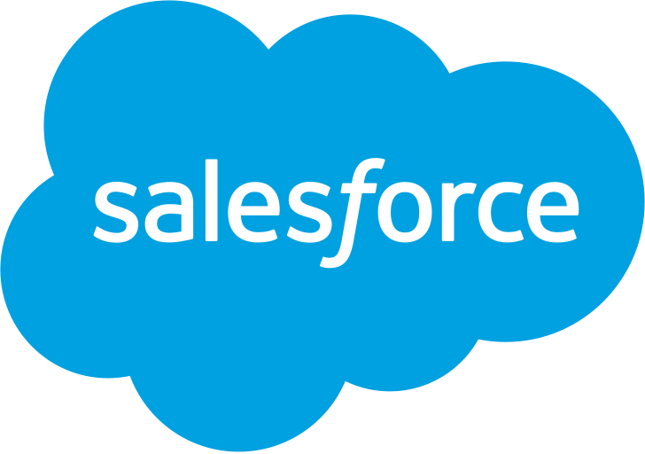
IaaS Overview
Traditional
on-premises
Infrastructure
(as a Service)
Platform
(as a Service)
Software
(as a Service)
Applications
Applications
Applications
Applications
Data
Data
You manage
Data
Data
Runtime
You manage
Runtime
Runtime
Runtime
Middleware
Middleware
Middleware
Middleware
You manage
O/S
O/S
O/S
Managed by vendor
O/S
Virtualization
Virtualization
Managed by vendor
Virtualization
Virtualization
Servers
Managed by vendor
Servers
Servers
Servers
Storage
Storage
Storage
Storage
Networking
Networking
Networking
Networking
You manage
Managed by vendor
Notes:
As you can see, the cloud journey includes many service scenarios:
On the left, you have a traditional, on-premises infrastructure which you manage completely on your own.
On the right, you have Software-as-a-Service, which includes all of the web-based tools and applications you use to run your business—think of Office 365 or Dynamics 365—running completely in the cloud, and managed fully by the vendor that provides the software.
In the middle, we have infrastructure and platform services. Building out your cloud infrastructure is your first step in moving to the cloud.
Infrastructure as a service (IaaS) is an instant computing infrastructure, provisioned and managed over the Internet. It enables you to quickly scale up and down with demand, and pay only for what you use.
IaaS helps you avoid the expense and complexity of buying and managing your own physical servers and other datacenter infrastructure.
Each resource is offered as a separate service component, and you only need to rent a particular one for as long as you need it.
The cloud computing service provider manages the infrastructure, while you purchase, install, configure, and manage your own software—operating systems, middleware, and applications.

Slide 15
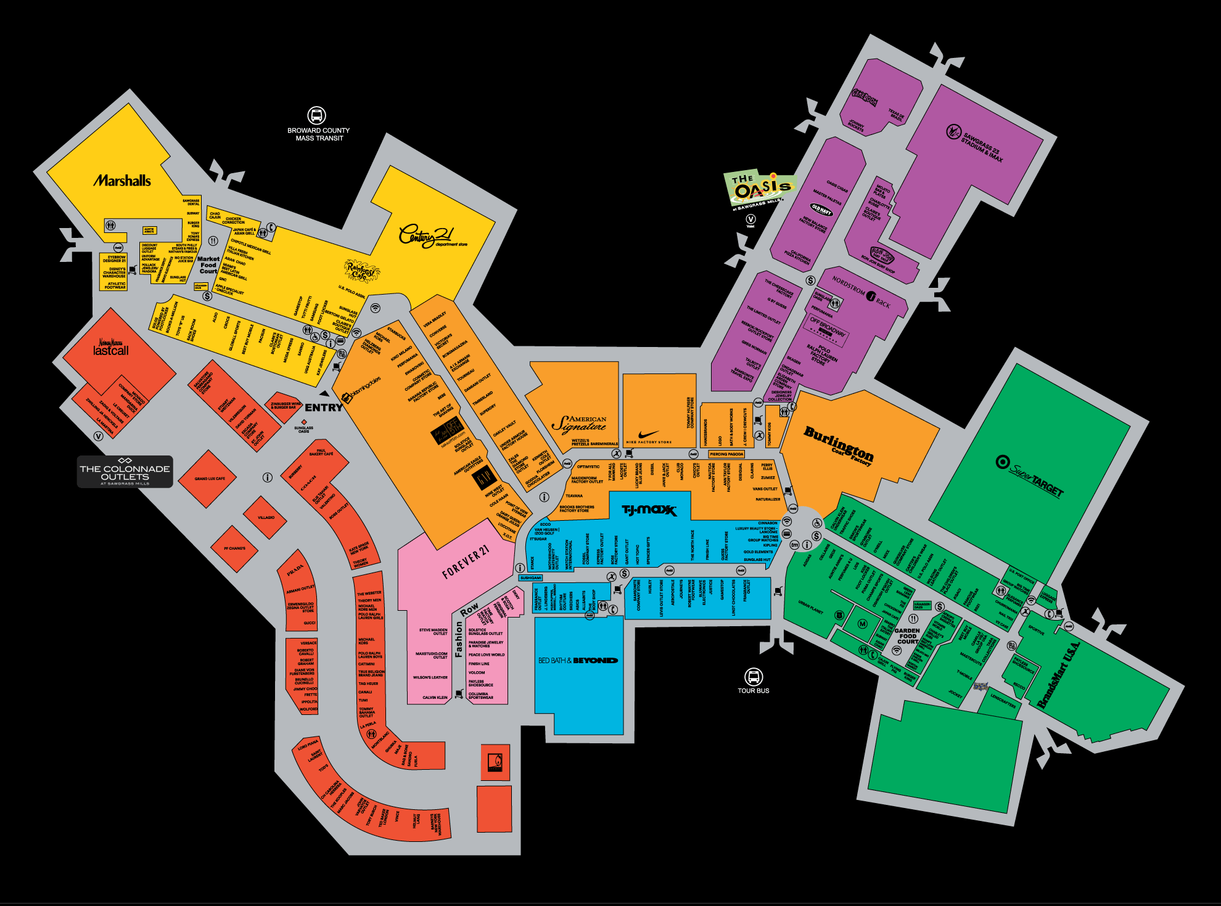
The Mall
Notes:
Pero… aqui… aqui esta differente!
Alguien ha estado aqui?!
Alguien concoce este lugar?
Este es un centro comercial circa de Miami. Se llama “Sawgrass Mills”.
Yo fui a este lugar una vez. Hace diez anos? No me recuerdo
Si no sabe lo que quiere comprar…
es facil perderse aqui?!
Se necesitan una guia!

Slide 16
Azure
Overview & Basics
Storage
Compute
Security & Management
Networking
Data & Analytics
Notes:
No es una problema!
yo seré su guía
Voy a dar un recorrido por el centro comercial del AZURE!
El centro comercial tiene diferentes secciones
Y tambien, Azure tiene diferentes secciones mejor.
Vamos a caminar juntos a los secciones del Azure (centro comercial.)
No vamos a entrar en los detalles de cada servicio. Solo explorarémos los servicios en cada sección para que los conocen.
Despues de este presentacion, ustedes deben conocer Azure mejor!
Y tambien, ustedes deben poder dar un recorrido por lo mismo a sus clientes y sus socios

Slide 17
An area within the mall
Compute

Slide 18
Azure Resource Manager (ARM)
All services offered as ARM resources
Consistent model for creating/managing Azure resources
Based on declarative templates
Resources are managed in resource groups
Deployed together
Managed together
Provides RBAC support
Notes:
Demo: Resource Explorer

Slide 19
Azure Resource Manager Terminology
Resource
A manageable unit of Azure infrastructure
Examples: virtual machine, load balancer, storage account
Resource provider
A service that allows for creation and management of resources
Examples: Compute Resource Provider, Storage Resource Provider
Resource manager template
A declarative template for describing a resource group

Slide 20
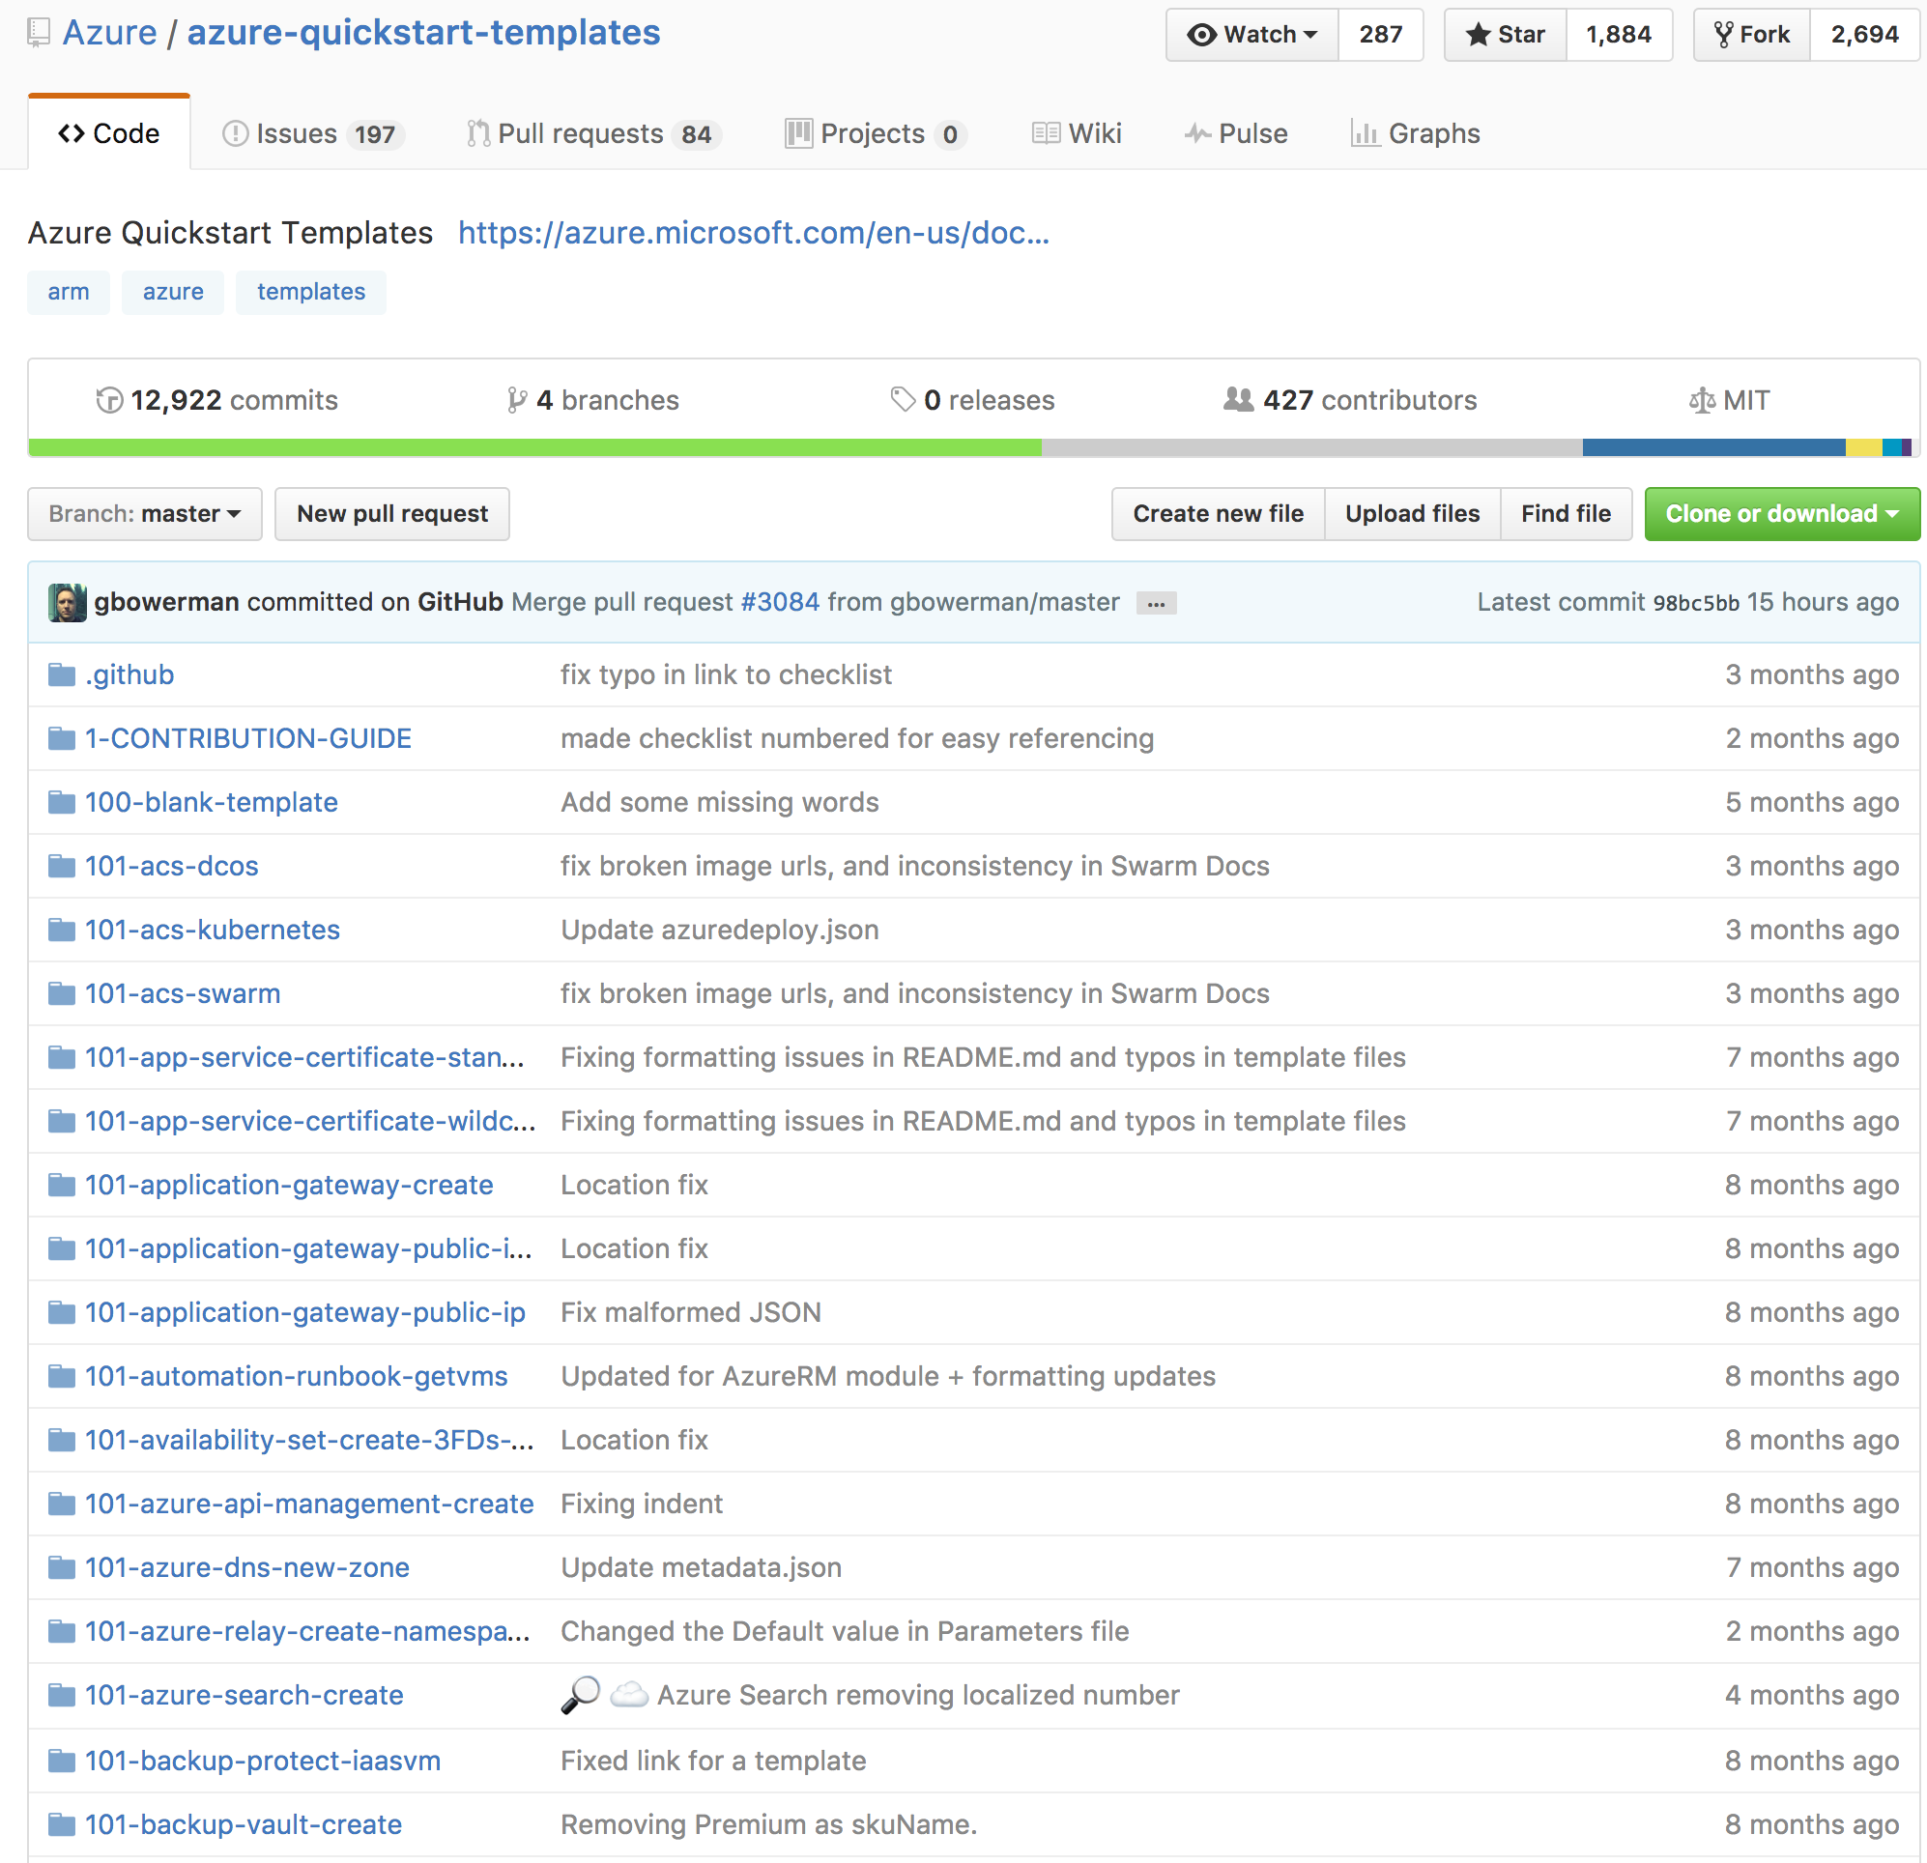
Reusable ARM templates
A declarative template for describing a resource group
Community offered or Build your own
Learn about template here:
https://azure.microsoft.com/en-us/resources/templates/
Notes:
Demo Azure getting started templates

Slide 21

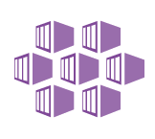



Azure: The Power Of Choice
Compute
Virtual Machines
Container Service
Service Fabric
App Service
Functions
More Control
Focus on the App
Customer-managed
(IaaS)
Platform-managed
(PaaS)
Code-only
(serverless)
Notes:
Azure IaaS is designed for high-end workloads and will automatically scale up or down to 1000 instances
Azure has all the power & flexibility of a Virtual Machine:
Minimal learning curve for existing virtualization pros
Run most Windows or Linux-based workloads
Easiest target for migrating to the cloud
Flexible instance sizes—use the best fit for your workload
Advanced networking and storage capabilities
Per second billing with pay-as-you-go billing (or RI)
For existing virtualization pros, the learning curve is minimal as Azure runs on most Windows or Linux-based workloads
Virtual Machines offer advanced networking & storage capabilities
Virtual Machine Scale Sets:
All of the power and flexibility of a Virtual Machine
Designed for high-end workloads
Automatically scale up (or down) to 1000 instances
Availability Sets:
Disks: Persistent, secured disk storage for Azure Virtual Machines
Simple scaling on demand lets you create thousands of disks simultaneously in minutes
Industry-leading durability and availability simultaneously replicates your data to three different replicas.
Offers you more security with granular access control
Lets you easily migrate in minutes
Multiple storage options available

Slide 22
Compute
IaaS VMs
VM Scale Sets
Batch
Logic Apps
Functions
App Service
Azure Container Service
Azure Container Instances
Service Fabric
Cloud Services
SERVERS!
SERVERLESS!
https://aka.ms/comparecompute

Slide 23
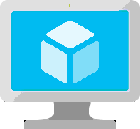
Virtual Machines
Ubuntu, Red Hat, Windows, SUSE, CoreOS
DevOps Extensions with Chef and Puppet
Multiple sizes
Hundreds of items in marketplace
Notes:
Really the basic building block of all other compute services
Valuable for cases where you’re simply lifting-and-shifting an existing workload to the cloud and want to maintain the existing topology.
Huge variety of OS images available, including all the popular Linux distros
Support for many popular configuration tools, including Chef and Puppet.
Available in many different sizes to fit your workload, including the recently announced N-series which offer Nvidia GPUs for graphically intense workloads.
And of course, since VMs make up the basic building blocks in our Compute story, many people have built interesting things out of them, which are available in the marketplace…

Slide 24
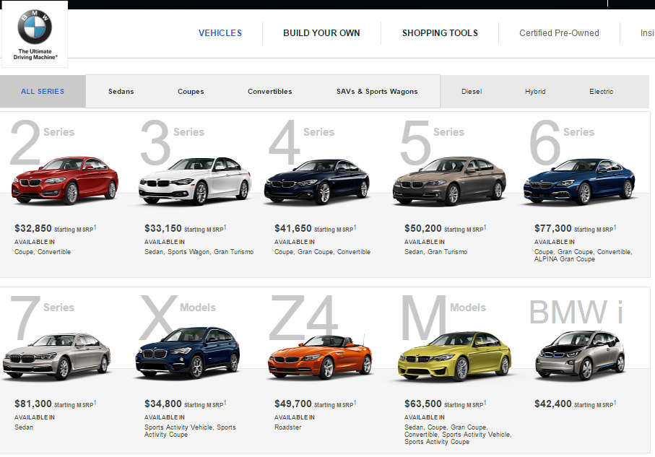
Notes:
Tiers – Define a set of capabilities that all VM sizes within the tier provide
Standard Tier - Offers the most flexibility. Supports all virtual machine configurations and features.
Basic Tier - An economical option for development workloads, test servers, and other applications that don't require load balancing, auto-scaling, or memory-intensive virtual machines.
Series – Define a set of capabilities based on the underlying host hardware the virtual machines run on
A Series – The first series of Azure IaaS virtual machines
D Series – Feature solid state drives (SSDs) and faster processors than the A-series and are also available for web or worker roles in Azure Cloud Services. This series is ideal for applications that demand faster CPUs, better local disk performance, or higher memories.
Size – Define a combination of CPU, RAM, and Disk
Example size: A2 - 2 CPU, 3.50 GB RAM, 135.00 GB Disk

Slide 25
Introducing the Latest Azure VM Line Up

Slide 26

Compute options for all types of apps
Entry level
Burstable
General Purpose
Compute Intensive
Storage Optimized
A
Av2
B
D
Dv2
Dv3
F
Fv2
L
High Performance Computing
Purpose-built SAP HANA
Memory Optimized
Graphics Intensive
G
Ev3
M
NC
NCv2
NV
ND
H
HANA
NCv3
Notes:
Key Messages: This slide simply sets the stage. Azure compute offers a rich development environment and IaaS capabilities that can help you develop a broad range of applications. For each type of application you can select the right VM that best suits your needs. We continue to expand and enrich the variety of VMs available to you so you can continue to fuel your innovation and growth to Azure.
Products recently introduced include:
1. M-Series VMs now certified for SAP HANA. You can now develop applications on Azure for the SAP HANA platform that has been recently certified for M-Series. The M-series family of Azure virtual machines are the largest memory-optimized VMs to date. These VMs are ideal for heavy in-memory workloads such as SAP HANA. With the M-Series, these databases can load large datasets into memory and utilize the fast memory access with huge amounts of vCPU parallel processing to speed up queries and enable real-time analytics. You can deploy these large workloads in minutes and on-demand, scaling elastically as your usage demands. Refer to the blog for the announcement https://azure.microsoft.com/en-us/blog/azure-m-series-vms-are-now-sap-hana-certified/
2. NVIDIA’s latest GPU for HPC and AI is available in Azure. For those of you focused on HPC applications and AI, not too long ago we announced major expansion of our GPU fleet. NVIDIA GPUs are at the heart of a lot of discovery and innovation. And with our tools like Batch, Batch AI, and the Data Science Virtual Machine images, Azure customers and developers are in a great position to expand what is possible and bring to market innovative AI and HPC applications.https://azure.microsoft.com/en-us/blog/ncv3-vms-generally-available-other-gpus-expanding-regions/ NCv3 brings NVIDIA’s latest GPU – the Tesla V100 – to our best-in-class HPC, machine learning, and AI products to bring huge amounts of value across a variety of industries. One preview customer told us their speech recognition models trained in less than 20 minutes, instead of the 1-2 hours that previous generation GPUs required. Another customer told us about the 40-50% performance boost they saw on their reservoir simulations. The ND-series, powered by NVIDIA Tesla P40 GPUs based on the new Pascal Architecture, will be excellent for training and inference. These instances will provide more than twice the performance over the previous generation for AI workloads utilizing CNTK, TensorFlow, Caffe, and other frameworks. The ND-series also offer a much larger GPU memory size (24 gigabytes), enabling you to fit much larger neural net models. Also, like our NC-series, the ND-series will offer RDMA and InfiniBand connectivity, so you will be able to run large-scale training jobs spanning hundreds of GPUs.
3. We have also announced two new VM sizes, E64i_v3 and E64is_v3, which are isolated to hardware and dedicated to a single customer. These VMs are best suited for workloads that require a high degree of isolation from other customers for compliance and regulatory requirements. You can also choose to further subdivide the resources by using Azure’s support for nested VMs. The E64i_v3 and E64is_v3 will have the exact same performance and price as their cousins E64_v3 and E64s_v3 and will be available in each of the regions where E64_v3 and E64s_v3 are available today. The small letter ‘i’ in the VM name denotes that they are “Isolated” sizes. Unlike the E64_v3 and E64s_v3, the two new E64i_v3 and E64is_v3 sizes are hardware bound sizes. They will live and operate on our Intel® Xeon® Processor E5-2673 v4 2.3GHz hardware only and will be available until at least December 2021. We will provide reminders 12 months in advance of the official decommissioning of the sizes and offer an updated isolated size like these sizes on our next hardware version. These two new E64i_v3 and E64is_v3 sizes will be available in the on-demand portal. Starting on May 1st, 2018, they will also be made available for purchase as 1-year Reserved VM Instances.
The E64i_v3 and E64is_v3 are joining our other Isolated VM sizes in the Azure family:
Standard_D15_v2
Standard_DS15_v2
Standard_E64i_v3
Standard_E64is_v3
Standard_F72s
Standard_G5
Standard_GS5
Standard_L32s
Standard_M128ms
Standard_M128s
We encourage you to use these VMs for workloads needing a high degree of isolation.
----------------------------------------
BACKGROUND INFO
Entry Level
A-series VMs have CPU performance and memory configurations best suited for entry-level workloads like development and test. They are economical and provide a low-cost option to get started with Azure.
Example use cases include development and test servers, low-traffic web servers, small-to-medium databases, servers for proof-of-concepts, and code repositories.
Burstable
B-series are economical virtual machines that provide a low-cost option for workloads that typically run at a low-to-moderate baseline CPU utilization, but sometimes need to burst to significantly higher CPU utilization when the demand rises.
Example use cases include development and test servers, low-traffic web servers, small databases, micro services, servers for proof-of-concepts, and build servers.
General Purpose
The Dv3 and Ev3 sizes are able to run Windows 2016 hosts and enable Nested Virtualization and Hyper-V Containers for these new VM sizes. Nested virtualization allows you to run a Hyper-V server on an Azure virtual machine. With nested virtualization, you can run a Hyper-V Container in a virtualized container host, set up a Hyper-V lab in a virtualized environment, or to test multi-machine scenarios. You can find more information on Nested Virtualization on Azure.
Our new Dv3 VM sizes are a good balance of memory to vCPU performance, with up to 64 vCPUs and 256 GiB of RAM. Our newly named Ev3 sizes provide you with more memory to vCPU than the Dv3, so you can run larger workloads on sizes up to our largest E64 size, with 64 vCPUs and 432 GiB of RAM. D2v3 instances are the latest hyper-threaded generation of general purpose instances.
Compute Intensive
The F-series VM sizes sport a higher CPU-to-memory ratio. They feature 2 GB RAM and 16 GB of local Solid State Drive (SSD) per CPU core, and are optimized for compute-intensive workloads. The F-series is based on the 2.4 GHz Intel Xeon E5-2673 v3 (Haswell) processor, which can achieve clock speeds as high as 3.1 GHz with the Intel Turbo Boost Technology 2.0. Example use cases include scenarios like batch processing, web servers, analytics, and gaming.
Azure now offers the fastest Intel Xeon Scalable processor, code-named Skylake, in the public cloud. In Azure, we have seen growing demand for massive large-scale computation by customers doing financial modeling, scientific analysis, genomics, geothermal visualization, and deep learning. Our drive to continuously innovate in Azure allows us to offer cost-effective and best-in-class hardware for these world-changing workloads.
Memory Optimized
The M-series family of Azure virtual machines are the largest memory optimized VMs to date. These VMs are ideal for heavy in-memory workloads, such as SAP HANA. With the M-series, these databases can load large datasets into memory and utilize the fast memory access with huge amounts of vCPU parallel processing to speed up queries and enable real-time analytics. You can deploy these large workloads in minutes and on-demand, scaling elastically as your usage demands.
G-series VMs feature the latest Intel Xeon processor E5 v3 family, two times more memory, and four times more Solid State Drive storage (SSDs) than the General Purpose D-series. G-series sport RAM of up to ½ TB and 32 CPU cores, and provide unparalleled computational performance, memory, and local SSD storage for your most demanding applications. Example use cases include large SQL and NoSQL databases, ERP, SAP, and data warehousing solutions.
Optimized for in-memory hyper-threaded applications, the E-series family of Azure virtual machines are optimized for heavy in-memory applications such as SAP HANA. These VMs are set up with high memory-to-core ratios that make them well-suited for relational database servers, with medium-to-large caches, and in-memory analytics. The E-series VMs range from 2 to 64 vCPUs and 16 to 432 GiB RAM, respectively.
Two new VM sizes, E64i_v3 and E64is_v3, which are isolated to hardware and dedicated to a single customer. These VMs are best suited for workloads that require a high degree of isolation from other customers for compliance and regulatory requirements. The E64i_v3 and E64is_v3 will have the exact same performance and price as their cousins E64_v3 and E64s_v3, and they will be available in each of the regions where E64_v3 and E64s_v3 are available today. The small letter “I” in the VM name denotes that they are “Isolated” sizes.
Graphics Intensive
NCv3 is available in East and South Central regions in the US. NCv3 brings NVIDIA’s latest GPU – the Tesla V100 – to our best-in-class HPC, machine learning, and AI products to bring huge amounts of value across a variety of industries. One preview customer told us their speech recognition models trained in less than 20 minutes, instead of the 1-2 hours that previous generation GPUs required. Another customer told us about the 40-50% performance boost they saw on their reservoir simulations.
The ND-series, powered by NVIDIA Tesla P40 GPUs based on the new Pascal Architecture, will be excellent for training and inference. These instances will provide more than twice the performance over the previous generation for FP32 (single-precision floating-point operations), for AI workloads utilizing CNTK, TensorFlow, Caffe, and other frameworks. The ND-series also offer a much larger GPU memory size (24 gigabytes), enabling you to fit much larger neural net models. Also, like our NC-series, the ND-series will offer RDMA and InfiniBand connectivity, so you will be able to run large-scale training jobs spanning hundreds of GPUs. They are available in East and West US and Southeast Asia.
HPC
H-series VM sizes are suitable for any compute-intensive workload like complex engineering and scientific workloads like computational fluid dynamics, crash simulations, seismic exploration, and weather forecasting simulations. H-series VMs come with the fastest CPUs in public cloud, as well as RDMA with InfiniBand, which allows you to run high-performance computing (HPC) apps. The H-series is available across multiple regions in the US, Europe, and Asia.
Azure offers a comprehensive set of compute options for all types of apps, including entry-level, general purpose, memory optimized, storage optimized, and compute intensive.
Our HPC and GPU fleet has fast performance with built-in Infiband support. Let’s take a look at some of the new compute types we’ve added:
H-series: InfiniBand networking (industry-leading)
SAP Large Instances up to to 20 TB (industry-leading)
Fast networking (FPGA) – up to 30 gb/s from 25 gb/s last year (industry-leading)

Slide 27
.. From entry-level to storage optimized …
Intel Haswell E5-2673 v3
Lowest cost, flexible CPUs
Up to 8vCPUs, 32GiB RAM
Intel® Xeon® Platinum 8168 processor (Skylake)
Entry level
Burstable
General Purpose
Compute Intensive
Storage Optimized
A
Av2
B
D
Dv2
Dv3
F
Fv2
L
Intel Broadwell E5-2673 v4
Hyper-Threaded CPUs
Up to 64 vCPU’s, 256GB RAM
Notes:
Entry Level
A-series VMs have CPU performance and memory configurations best suited for entry-level workloads like development and test. They are economical and provide a low-cost option to get started with Azure.
Example use cases include development and test servers, low-traffic web servers, small-to-medium databases, servers for proof-of-concepts, and code repositories.
Burstable
B-series are economical virtual machines that provide a low-cost option for workloads that typically run at a low-to-moderate baseline CPU utilization, but sometimes need to burst to significantly higher CPU utilization when the demand rises.
Example use cases include development and test servers, low-traffic web servers, small databases, micro services, servers for proof-of-concepts, and build servers.
General Purpose
The Dv3 and Ev3 sizes are able to run Windows 2016 hosts and enable Nested Virtualization and Hyper-V Containers for these new VM sizes. Nested virtualization allows you to run a Hyper-V server on an Azure virtual machine. With nested virtualization, you can run a Hyper-V Container in a virtualized container host, set up a Hyper-V lab in a virtualized environment, or to test multi-machine scenarios. You can find more information on Nested Virtualization on Azure.
Our new Dv3 VM sizes are a good balance of memory to vCPU performance, with up to 64 vCPUs and 256 GiB of RAM. Our newly named Ev3 sizes provide you with more memory to vCPU than the Dv3, so you can run larger workloads on sizes up to our largest E64 size, with 64 vCPUs and 432 GiB of RAM. D2v3 instances are the latest hyper-threaded generation of general purpose instances.
Compute Intensive
The F-series VM sizes sport a higher CPU-to-memory ratio. They feature 2 GB RAM and 16 GB of local Solid State Drive (SSD) per CPU core, and are optimized for compute-intensive workloads. The F-series is based on the 2.4 GHz Intel Xeon E5-2673 v3 (Haswell) processor, which can achieve clock speeds as high as 3.1 GHz with the Intel Turbo Boost Technology 2.0. Example use cases include scenarios like batch processing, web servers, analytics, and gaming.
Azure now offers the fastest Intel Xeon Scalable processor, code-named Skylake, in the public cloud. In Azure, we have seen growing demand for massive large-scale computation by customers doing financial modeling, scientific analysis, genomics, geothermal visualization, and deep learning. Our drive to continuously innovate in Azure allows us to offer cost-effective and best-in-class hardware for these world-changing workloads.
B-series:
Web servers, small DBs, and dev/test
Dv3
Hyper-Threaded CPUs unlock full potential of latest processors
First wave for Nested virtualization and Hyper-V containers
Fv2:
For HPC scenarios: Scientific modeling, cluster computing, gaming and analytics

Slide 28
.. From memory optimized to HPC
Nvidia P100 GPU
InfiniBand networking
HPC scenarios
Intel Xeon E5-2673 v4 (Broadwell)
Hyper-Threaded CPUs
Up to 64 vCPUs, 432GiB RAM
High Performance Computing
Purpose-built SAP HANA
Memory Optimized
Graphics Intensive
G
Ev3
M
NC
NCv2
NV
ND
H
HANA
‘
Intel Xeon E7-8890 v3 (Haswell)
Largest VMs in Azure
Up to 128 vCPUs, 4TiB RAM
Skylake Processor
Notes:
NVIDIA’s latest GPU for HPC and AI is available in Azure. For those of you focused on HPC applications and AI, not too long ago we announced major expansion of our GPU fleet. NVIDIA GPUs are at the heart of a lot of discovery and innovation. And with our tools like Batch, Batch AI, and the Data Science Virtual Machine images, Azure customers and developers are in a great position to expand what is possible and bring to market innovative AI and HPC applications.https://azure.microsoft.com/en-us/blog/ncv3-vms-generally-available-other-gpus-expanding-regions/ NCv3 brings NVIDIA’s latest GPU – the Tesla V100 – to our best-in-class HPC, machine learning, and AI products to bring huge amounts of value across a variety of industries. One preview customer told us their speech recognition models trained in less than 20 minutes, instead of the 1-2 hours that previous generation GPUs required. Another customer told us about the 40-50% performance boost they saw on their reservoir simulations. The ND-series, powered by NVIDIA Tesla P40 GPUs based on the new Pascal Architecture, will be excellent for training and inference. These instances will provide more than twice the performance over the previous generation for AI workloads utilizing CNTK, TensorFlow, Caffe, and other frameworks. The ND-series also offer a much larger GPU memory size (24 gigabytes), enabling you to fit much larger neural net models. Also, like our NC-series, the ND-series will offer RDMA and InfiniBand connectivity, so you will be able to run large-scale training jobs spanning hundreds of GPUs.
M-Series VMs now certified for SAP HANA. You can now develop applications on Azure for the SAP HANA platform that has been recently certified for M-Series. The M-series family of Azure virtual machines are the largest memory-optimized VMs to date. These VMs are ideal for heavy in-memory workloads such as SAP HANA. With the M-Series, these databases can load large datasets into memory and utilize the fast memory access with huge amounts of vCPU parallel processing to speed up queries and enable real-time analytics. You can deploy these large workloads in minutes and on-demand, scaling elastically as your usage demands. Refer to the blog for the announcement https://azure.microsoft.com/en-us/blog/azure-m-series-vms-are-now-sap-hana-certified/
Memory Optimized
The M-series family of Azure virtual machines are the largest memory optimized VMs to date. These VMs are ideal for heavy in-memory workloads, such as SAP HANA. With the M-series, these databases can load large datasets into memory and utilize the fast memory access with huge amounts of vCPU parallel processing to speed up queries and enable real-time analytics. You can deploy these large workloads in minutes and on-demand, scaling elastically as your usage demands.
G-series VMs feature the latest Intel Xeon processor E5 v3 family, two times more memory, and four times more Solid State Drive storage (SSDs) than the General Purpose D-series. G-series sport RAM of up to ½ TB and 32 CPU cores, and provide unparalleled computational performance, memory, and local SSD storage for your most demanding applications. Example use cases include large SQL and NoSQL databases, ERP, SAP, and data warehousing solutions.
Optimized for in-memory hyper-threaded applications, the E-series family of Azure virtual machines are optimized for heavy in-memory applications such as SAP HANA. These VMs are set up with high memory-to-core ratios that make them well-suited for relational database servers, with medium-to-large caches, and in-memory analytics. The E-series VMs range from 2 to 64 vCPUs and 16 to 432 GiB RAM, respectively.
Two new VM sizes, E64i_v3 and E64is_v3, which are isolated to hardware and dedicated to a single customer. These VMs are best suited for workloads that require a high degree of isolation from other customers for compliance and regulatory requirements. The E64i_v3 and E64is_v3 will have the exact same performance and price as their cousins E64_v3 and E64s_v3, and they will be available in each of the regions where E64_v3 and E64s_v3 are available today. The small letter “I” in the VM name denotes that they are “Isolated” sizes.

Slide 29

Big Compute on IaaS
Virtual Machines
Infiniband
H
N
High Performance VMs
Batch processing, fluid dynamics, monte carlo simulation
GPU-enabled VMs
NV -Graphic based applications
NC – Advanced simulation
ND– Artificial Intelligence
Cray in Azure
Dedicated supercomputer on the Azure Virtual Network
Azure Batch
Create cloud-native HPC applications
Batch AI
Batch Rendering
CycleCloud
Manage HPC clusters and hybrid workflows
Avere Systems
Performant storage for HPC workloads
Notes:
In short, Azure Batch enables developers to write new Big Compute/HPC applications easily, while CycleCloud helps IT/LoBs move existing HPC applications to hybrid or Azure-only architectures with policy and cost control, without rewriting them. I’ve attached two slides that we’ve used in various presentations to help clarify the difference with more details. Let me know if I can help clarify anything here.
> Also, they should be selling Cycle now, right? YES! We have a current target of April for an official Microsoft release binary, with a SKU in early May.
>Finally, should I call out Avere here and how that is going to integrate beautifully?
Yes, Avere helps enable certain hybrid data access scenarios (Cycle has several mutual customers with Avere), and it will power a fast, cost-effective NFS mount to Azure Blob Storage for the many Batch & CycleCloud Big Compute workloads, that need scalable filesystem access.
Azure IaaS is designed for high-end workloads and will automatically scale up or down to 1000 instances
Azure has all the power & flexibility of a Virtual Machine:
Minimal learning curve for existing virtualization pros
Run most Windows or Linux-based workloads
Easiest target for migrating to the cloud
Flexible instance sizes—use the best fit for your workload
Advanced networking and storage capabilities
Per second billing with pay-as-you-go billing (or RI)
For existing virtualization pros, the learning curve is minimal as Azure runs on most Windows or Linux-based workloads
Virtual Machines offer advanced networking & storage capabilities
Virtual Machine Scale Sets:
All of the power and flexibility of a Virtual Machine
Designed for high-end workloads
Automatically scale up (or down) to 1000 instances
Availability Sets:
Disks: Persistent, secured disk storage for Azure Virtual Machines
Simple scaling on demand lets you create thousands of disks simultaneously in minutes
Industry-leading durability and availability simultaneously replicates your data to three different replicas.
Offers you more security with granular access control
Lets you easily migrate in minutes
Multiple storage options available

Slide 30
VM Sizes
Type | Sizes | Description
General purpose | B (Preview), Dsv3, Dv3, DSv2, Dv2, DS, D, Av2, A0-7 | Balanced CPU-to-memory ratio. Ideal for testing and development, small to medium databases, and low to medium traffic web servers.
Compute optimized | Fs, F | High CPU-to-memory ratio. Good for medium traffic web servers, network appliances, batch processes, and application servers.
Memory optimized | Esv3, Ev3, M, GS, G, DSv2, DS, Dv2, D | High memory-to-CPU ratio. Great for relational database servers, medium to large caches, and in-memory analytics.
Storage optimized | Ls | High disk throughput and IO. Ideal for Big Data, SQL, and NoSQL databases.
GPU | NV, NC | Specialized virtual machines targeted for heavy graphic rendering and video editing. Available with single or multiple GPUs.
High performance compute | H, A8-11 | Our fastest and most powerful CPU virtual machines with optional high-throughput network interfaces (RDMA).
Notes:
B series - https://buildazure.com/2017/09/11/more-affordable-azure-vms-with-burstable-b-series/
Determine Cores, RAM, ACUs, Disks, NICs, Network Speed, Temporary Storage, SSD support
High level categories:
Acu helps normalize cpu perf.. D&f have same acu

Slide 31
VM Azure Compute Unit (ACU)
SKU Family | ACU \ vCPU
A0 | 50
A1-A4 | 100
A5-A7 | 100
A1_v2-A8_v2 | 100
A2m_v2-A8m_v2 | 100
A8-A11 | 225*
D1-D14 | 160
D1_v2-D15_v2 | 210 - 250*
DS1-DS14 | 160
DS1_v2-DS15_v2 | 210-250*
D_v3 | 160-190* **
Ds_v3 | 160-190* **
E_v3 | 160-190* **
Es_v3 | 160-190* **
F1-F16 | 210-250*
F1s-F16s | 210-250*
G1-G5 | 180 - 240*
GS1-GS5 | 180 - 240*
H | 290 - 300*
L4s-L32s | 180 - 240*
M | 160-180**
Provide a way of comparing compute (CPU) performance across Azure SKUs
Not all Azure Cores are created equal
A1 Core != F1 Core
Compare compute (CPU) performance across SKUs.
Notes:
Not all Azure Cores are created equal
A1 Core != F1 Core
Compare compute (CPU) performance across SKUs.
https://docs.microsoft.com/en-us/azure/virtual-machines/windows/acu
Azure Compute Unit (ACU) to provide a way of comparing compute (CPU) performance across Azure SKUs. This will help you easily identify which SKU is most likely to satisfy your performance needs. ACU is currently standardized on a Small (Standard_A1) VM being 100 and all other SKUs then represent approximately how much faster that SKU can run a standard benchmark.
ACUs marked with a * use Intel® Turbo technology to increase CPU frequency and provide a performance boost. The amount of the boost can vary based on the VM size, workload, and other workloads running on the same host.+
**Hyper-threaded.

Slide 32
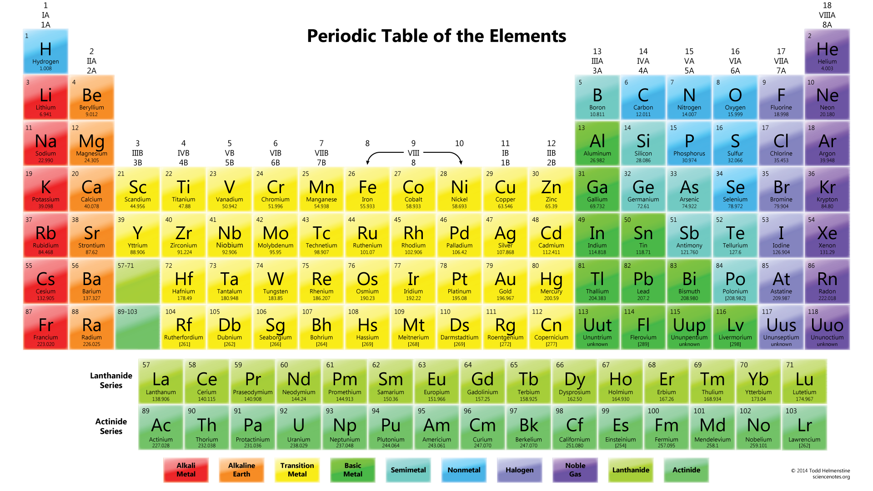
The Fundamental Element of Azure

Slide 33
The Fundamental Element of Azure
St
1
Storage
Notes:
Flexibility at multiple levels -
Access level – hot storage or cold storage
Tier
Abstraction level – files, disks
Disk level – spindle, SSD, managed
Redundancy level – LRS, ZRS, GRS, RAGRS

Slide 34
VM Disks
OS Disk (attached via SATA)
VHD based
Persists
Separate storage cost
Temporary Disk
Doesn’t persist - SSD
No Separate storage cost
Data Disk (SCSI)
VHD based
Persists
Separate storage cost
Current Max Data Disk Size: 4095GB
Notes:
https://docs.microsoft.com/en-us/azure/storage/storage-premium-storage#scalability-and-performance-targets
The temporary disk is labeled as the D: drive by default and it used for storing pagefile.sys

Slide 35
Premium vs Standard (SSD vs HDD) Comparision
 | Azure Premium Disk | Azure Standard Disk
Disk Type | Solid State Drives (SSD) | Hard Disk Drives (HDD)
Overview | SSD-based high-performance, low-latency disk support for VMs running IO-intensive workloads | HDD-based cost effective disk support for Dev/Test VM scenarios
Scenario | Production and performance sensitive workloads | Dev/Test, non-critical, Infrequent access
Disk Size | P4: 32 GB (Managed Disks only) P6: 64 GB (Managed Disks only) P10: 128 GB P20: 512 GB P30: 1024 GB P40: 2048 GB P50: 4095 GB | Unmanaged Disks: 1 GB – 4 TB (4095 GB) Managed Disks: S4: 32 GB S6: 64 GB S10: 128 GB S20: 512 GB S30: 1024 GB S40: 2048 GB S50: 4095 GB
Max Throughput per Disk | 250 MB/s | 60 MB/s
Max IOPS per Disk | 7500 IOPS | 500 IOPS
Notes:
Managed disk - https://docs.microsoft.com/en-us/azure/virtual-machines/windows/managed-disks-overview
https://docs.microsoft.com/en-us/azure/storage/common/storage-premium-storage
Unmanaged disks
The original method is to use unmanaged disks. In an unmanaged disk, you manage the storage accounts that you use to store the virtual hard disk (VHD) files that correspond to your VM disks. VHD files are stored as page blobs in Azure storage accounts.
Managed disks
When you choose Azure Managed Disks, Azure manages the storage accounts that you use for your VM disks. You specify the disk type (Premium or Standard) and the size of the disk that you need. Azure creates and manages the disk for you. You don't have to worry about placing the disks in multiple storage accounts to ensure that you stay within scalability limits for your storage accounts. Azure handles that for you.
Throughput and IOPS are lower for smaller disks

Slide 36
VM Recommendations
Premium Storage for Production Workloads (Storage SLAs)
Choose a VM Size that works with premium storage for production
Use Managed Disks over Unmanaged Disks
Scaling Up/Down is just resizing the VM
Scaling In/Out – the VMs should be in an availability set
Use VM reboot logs to determine if VM was rebooted by planned maintenance
Use snapshots to prevent accidental data loss
Enable VM diagnostics for production (includes boot diagnostics)
Stopped VMs are still charged for use. VMs need to be deallocated to stop charges. Stopping through OS does not deallocate! Stop with portal or CLI.
Notes:
https://docs.microsoft.com/en-us/azure/architecture/reference-architectures/virtual-machines-linux/single-vm

Slide 37

High Availability

Slide 38
Most comprehensive resiliency and best SLA
INDUSTRY-ONLY
INDUSTRY-LEADING HIGH AVAILABILITY SLA
INDUSTRY-LEADING DISASTER RECOVERY
VM SLA
VM SLA
VM SLA
REGIONS 42
99.9%
99.95%
99.99%
Region 1
Region 2
SINGLE VM
AVAILABILITY SETS
AVAILABILITY ZONES
REGION PAIRS
Protection with Premium Storage
Protection against failures within datacenters
Protection from entire datacenter failures
Protection from disaster with Data Residency compliance
Notes:
Comprehensive set of native business continuity solutions
industry’s only single VM SLA.
99.9% SLA guarantee on Single Instance Virtual Machines which are backed by Premium Storage
High availability across datacenters
Availability zones – protect against loss of entire datacenters, 99.99% SLA at GA
Combination – higher than any other vendor
Disaster recovery and backup solutions
DR via Azure Site Recovery provides orchestrated failover.
Only Azure provides this comprehensive level of service

Slide 39
Defining Disaster Recovery within Azure
Disaster recovery is being able to recover your application into another Azure datacenter
Keywords:
RTO: Recovery Time Objective
RPO: Recovery Point Objective
Options range from:
Complete active/active deployment in multiple datacenters
Active/Passive deployment in multiple datacenters
Active deployment in one datacenter, with backups stored in 2nd datacenter

Slide 40
Understanding Azure VM Availability Single VM
Azure SLA guarantees no data loss, 99.9% uptime SLA*
Subject to un-planned maintenance events due to physical failures
If VM becomes unavailable, Azure migrates VM and restarts in another host
~10-15 minutes to complete this process

Slide 41
Understanding Azure VM Availability Single VM
Azure SLA guarantees no data loss, 99.9% uptime SLA*
Subject to un-planned maintenance events due to physical failures
If VM becomes unavailable, Azure migrates VM and restarts in another host
~10-15 minutes to complete this process
Subject to planned maintenance events due to host OS servicing
All VMs on host are shut down.
Host OS is serviced and rebooted
All VMs on host are restarted
~10-15 minutes to complete this process
Subject to in-memory planned maintenance events
All VMs on host are paused, Host patched, VMs un-paused. 30 seconds downtime

Slide 42
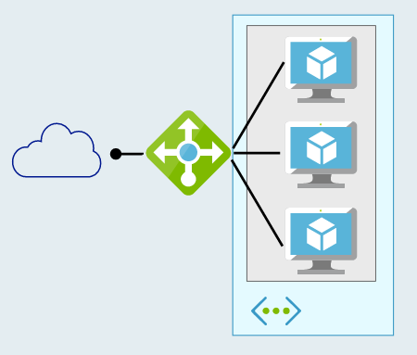
Defining High Availability 2 or more Azure VMs
Multiple VMs can be configured in an “availability set”
Workload is load balanced across the VMs
Azure SLA: 2 (or more) VMs in Availability Set:
99.95% (<22 min downtime p/month)
Includes
Planned downtime due to host OS servicing
Unplanned downtime due to physical failures
Doesn’t include servicing of guest OS or software inside (e.g. SQL)

Slide 43
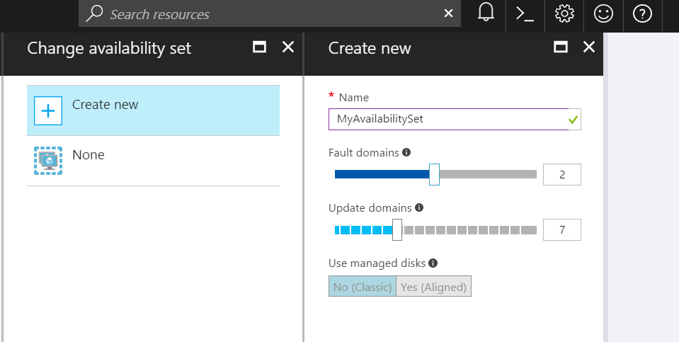
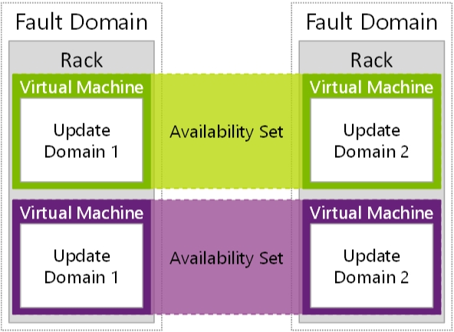
Availability Sets
Availability Sets are for Unplanned & Planned Maintenance
Fault Domains (2 default, some regions allow 3)
Upgrade Domains (5 default, 1-20 allowed)
Front with Load Balancer, App Gateway
Notes:
To provide redundancy to your application, we recommend that you group two or more virtual machines in an availability set.
Fault domain – collection of resources that may fail at the same time due to same root cause. Servers in same rack are part of same fault domain. A fault domain has a single point of failure. Place resources in separate fault domain so that they remain available in case of a failure
Update domain – logical collection of resources that can be updated at the same time. One update domain has updates applied at a time and may require rebooting. Pleace resources in separate update domains – it is automatic (indicate groups of virtual machines and underlying physical hardware that can be rebooted at the same time. )
One update domain has updates applied at a time
Availability set – can place vm’s in an availability set at creation or after deployment . Moving a vm in or out of availability set causes it to reboot
Fault domains
A fault domain is a logical group of underlying hardware that share a common power source and network switch, similar to a rack within an on-premises datacenter. As you create VMs within an availability set, the Azure platform automatically distributes your VMs across these fault domains. This approach limits the impact of potential physical hardware failures, network outages, or power interruptions.+
Update domains
An update domain is a logical group of underlying hardware that can undergo maintenance or be rebooted at the same time. As you create VMs within an availability set, the Azure platform automatically distributes your VMs across these update domains. This approach ensures that at least one instance of your application always remains running as the Azure platform undergoes periodic maintenance. The order of update domains being rebooted may not proceed sequentially during planned maintenance, but only one update domain is rebooted at a time.+
Managed Disk fault domains
For VMs using Azure Managed Disks, VMs are aligned with managed disk fault domains when using a managed availability set. This alignment ensures that all the managed disks attached to a VM are within the same managed disk fault domain. Only VMs with managed disks can be created in a managed availability set. The number of managed disk fault domains varies by region - either two or three managed disk fault domains per region. You can read more about these managed disk fault domains for Linux VMs or Windows VMs.
https://docs.microsoft.com/en-us/azure/virtual-machines/windows/manage-availability

Slide 44
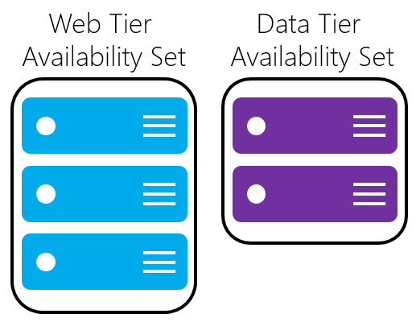
Availability Sets
Do NOT put a single VM in an Availability Set
Example - for an application,
Place front-end virtual machines in the same availability set
AND
Data-tier virtual machines in their own availability set
Notes:
Fault domain – collection of resources that may fail at the same time due to same root cause. Servers in same rack are part of same fault domain. A fault domain has a single point of failure. Place resources in separate fault domain so that they remain available in case of a failure
Update domain – logical collection of resources that can be updated at the same time. One update domain has updates applied at a time and may require rebooting. Place resources in separate update domains – it is automatic
One update domain has updates applied at a time
Availability set – can place vm’s in an availability set at creation or after deployment . Moving a vm in or out of availability set causes it to reboot

Slide 45
Availability Sets: How Do We Do It? Fault and Update Domains
Fault Domains
Represent groups of resources anticipated to fail together
i.e. Same rack, same server
Fabric spreads instances across fault at least 2 fault domains when two or more virtual machines are placed in an availability set
Update Domains
Represents groups of resources that will be updated together
Host OS updates honor service update domains
Specified in service definition
Default of 5 (up to 20)
Azure spreads role instances across Update Domains and Fault Domains

Slide 46
Virtual Machine Availability Sets Update Domains are honored by host OS updates
Fault Domain
Fault Domain
Rack
Rack
Availability Set
Virtual Machine
Virtual Machine
IIS1
IIS2
UD #1
UD #2
Availability Set
Virtual Machine
Virtual Machine
SQL1
SQL2
UD #1
UD #2

Slide 47
VM Scale Sets
High performance provisioning of 1000+ VMs
Auto-configuration at scale
Auto-scale based on schedule and resource metrics
Easy updates at scale
Simple Portal Integration
Notes:
So, VMs are great… but managing a lot of them individually can be hard. That’s where VM scale sets comes in..
The goal here is to enable management of like VMs as a group and make it easy to scale them in/out based on demand.

Slide 48
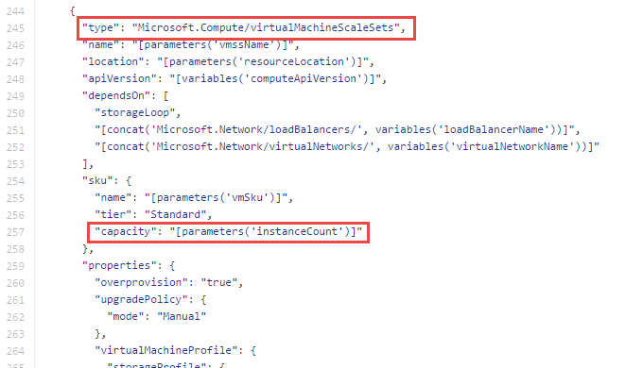
Why VM Scale Sets?
Manually scale with ‘capacity’ property
Autoscale with host metrics (MDM pipeline) or diagnostic extensions​
Small buy-in: Deploy/manage sets of 0->100 identically configured VMs ​
Guest OS patching: Patching primitives allow manually triggered rolling upgrades​​
High-availability – implicit availability set with 5 FDs/5 UDs​

Slide 49
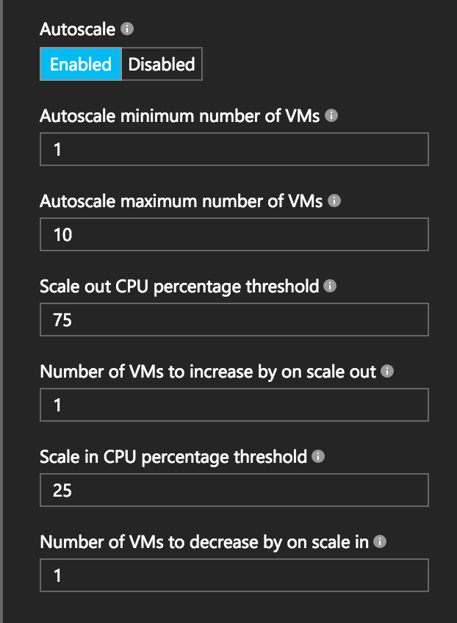
Autoscale with VM Scale Sets
Define Max – Min VMs
Define trigger and action rules
Standard audit / email notifications
Define webhooks for custom notifications and actions (e.g. runbooks)
Notes:
Metrics emitted by Azure Diagnostic Extension
Triggers can be basic performance metrics, and also schedule based, queue length based.

Slide 50


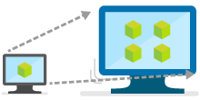
New VM Scale Sets enhancements
With VM Scale Sets, you can confidently deploy thousands of identical Virtual Machines in minutes and focus on what matters—your application.
Provides auto scale-out and scale-in based on health checks
Enables easy integration with Azure SLB or App Gateway
Auto-OS image update for guest images
Deploy low-priority VMs and realize cost savings
Support for cross-zone deployment
Public Preview
April ‘18
Notes:
We have recently introduced a number of enhancements to our Azure VMSS. As you may already know, with VM Scale Sets, you can confidently deploy hundreds of identical virtual machines in minutes. With easy updates at scale, focus more on what matters—your application—and less on the infrastructure. Virtual Machine Scale Sets are elastic and designed to support your scale-out applications —including stateless web front ends, container orchestration, and microservices clusters. Azure Container Service and Azure Service Fabric run on Virtual Machine Scale Sets.
We continue to add capabilities to increase the value we provide to our development community making it easier for you to develop applications on Azure. For example, now VMSS support Auto-OS image update https://azure.microsoft.com/en-us/updates/auto-os-upgrades/ for guest images, you do not have to worry about the scaling capabilities of your apps once they are in production, with recent capabilities announced in March you have support for cross-zone deployment to improve your SLAs.
Virtual Machine Scale Sets integrate with Azure networking resources such as Azure Load Balancer and Application Gateway. Easily spread your workloads across the virtual machines in your Virtual Machine Scale Set, and configure network address translation (NAT) rules to connect to specific virtual machine instances for troubleshooting.
Autoscale allows you to have the right amount of resources running to handle the load on your application. It allows you to add resources to handle increases in load and also save money by removing resources that are sitting idle. You specify a minimum and maximum number of instances to run and add or remove VMs automatically based on a set of rules. Having a minimum makes sure your application is always running even under no load. Having a maximum limits your total possible hourly cost. You automatically scale between these two extremes using rules you create.
Last but not least your users can now take advantage of support for low-priority VMs as they run the VMSS applications that you have developed.

Slide 51
VM scale set app deployment models
Model | When to use
Marketplace | Off the shelf solutions.
VM Extensions | Full control over app lifecycle management.
Custom data/unattend | Install custom app independently of external network.
Configuration manager | Centrally managed app installation, credentials & maintenance.
Containerized | Abstract app management from infrastructure. Cloud/DC agnostic.
Custom image | Small self-contained apps. Fast deploy. Immutable build, test, deploy pipelines.
Notes:
There are many different ways to deploy software to VM scale sets. I won’t go into any great detail here, but just to give you a flavor…
If you’re simply looking to deploy an existing application off-the-shelf, you can use the Azure marketplace
Alternatively, you can use what we call a VM extension, which is a task triggered inside the VM after the base image has booted, where you can run arbitrary scripts.
You can also deploy a custom VM image that you’ve created with a tool like Packer

Slide 52




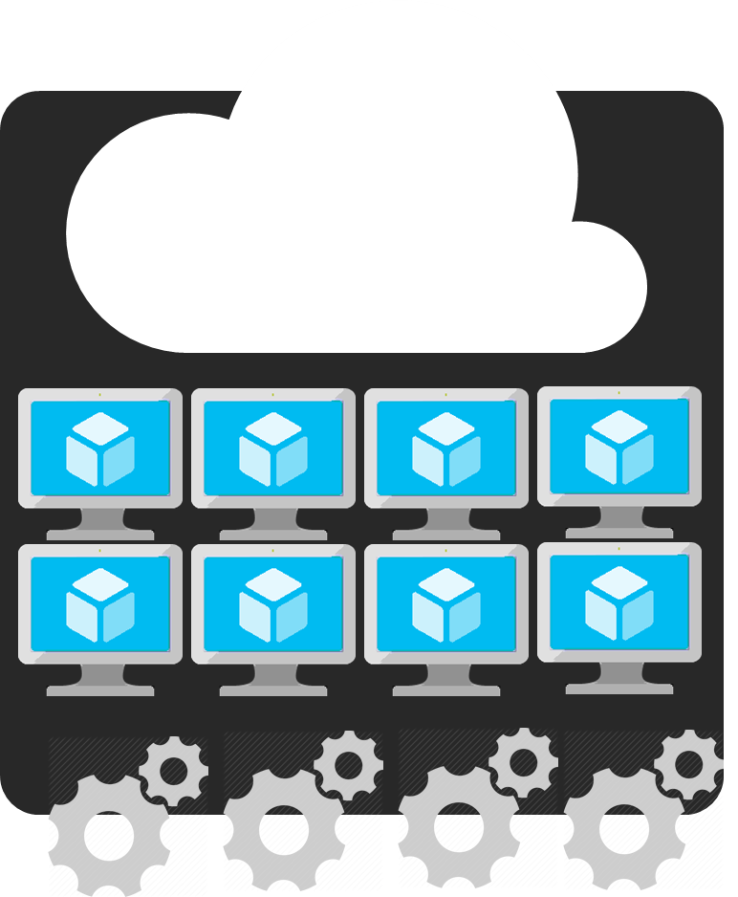
Azure Batch
APIM
Mobile apps
Logic apps
API apps
Notification hubs
Azure
functions
Compute pools for job processing
Automatic scaling and regional coverage
Linux and Windows
Automatically recover failed tasks
Input/Output handling
Low-Priority (discounted) option
Notes:
So with that little bit of context on VM scale sets, let’s start slowly moving up the stack…
While you can use VMSS directly, we expect most customers will interact with them through a higher-level abstraction.
One of those is Azure Batch, which enables highly-parallelizable job processing. You provide it with your job, configure the amount of compute you want to throw at it, and Batch will both schedule it efficiently and restart failed tasks as required.
Common scenarios include financial risk modeling, climate analysis, and media encoding

Slide 53
Azure: The Power Of Choice
Application Hosting (today)
Virtual Machines
Containers
Customer-managed
(IaaS)
Notes:
Azure provides several cloud-based compute offerings to run your application so that you don't have to worry about the infrastructure details.
You can easily scale up or scale out your resources as your application usage grows. Azure offers services that cover the spectrum—from providing infrastructure-as-a-service (IaaS) to give you full control over your application hosting, through platform-as-a-service (PaaS) where the services are hosted for you, to true serverless hosting where all you need to do is write your code.

Slide 54



Azure container technology
Azure Container Registry
Open source community
Azure Container Service (AKS)
Release automation tools
Getting started
Containers 101
Azure container technology
Open Service Broker for Azure (OSBA)
Customer success stories
Container orchestration
Azure Container Instances (ACI)

Slide 55



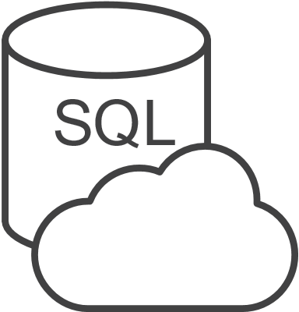


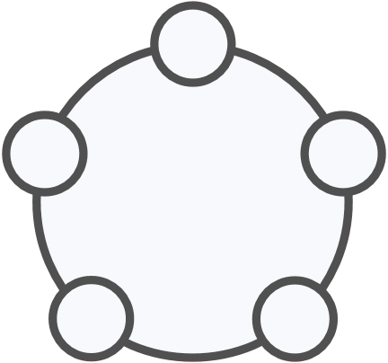
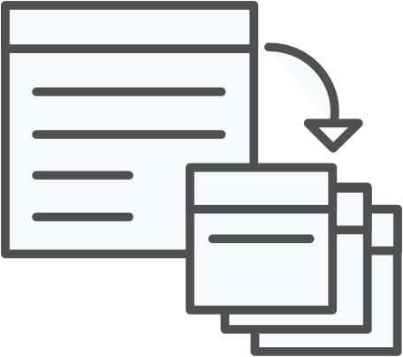


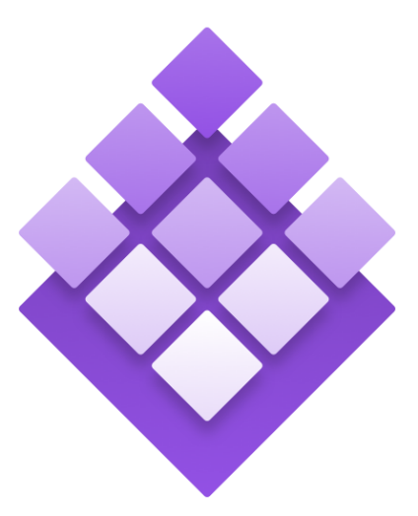
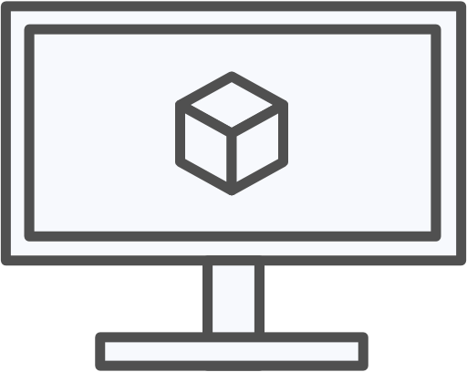
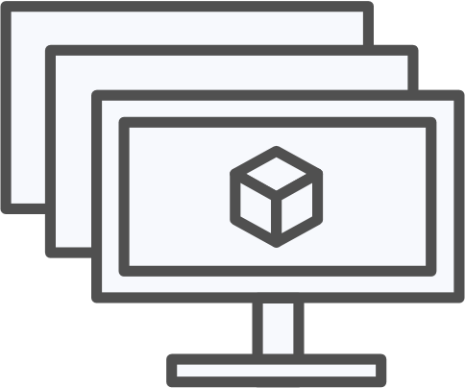
Azure container ecosystem
OSBA
App Service
Azure Container Registry (ACR)
Partner services
Azure services
PaaS
OpenShift
SQL Database
Azure Container Service (AKS)
Service Fabric
Batch
Pivotal Cloud Foundry
Redis Cache
ACS Engine
Docker Enterprise Edition
CosmosDB
Virtual kubelet
Mesosphere DC/OS
And more!
Azure Container Instances (ACI)
Azure Virtual Machines
Virtual Machine Scale Sets (VMSS)
Azure
IaaS

Slide 56
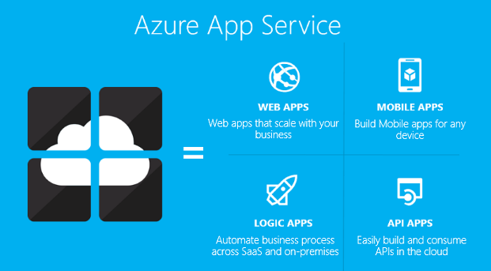
Azure App Service
Enterprise Security
Simple Access Control
Hybrid Connectivity
Seamless Integration
Notes:
App Service is a fully managed platform that brings a rich set of capabilities to web, mobile and integration scenarios

Slide 57
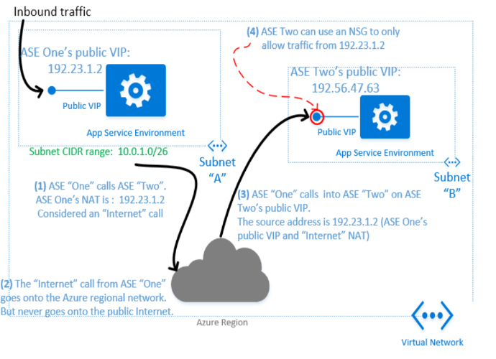
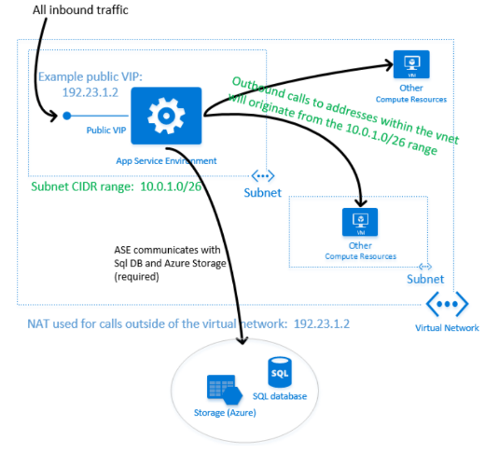
App Service Environment
App Service Premium Feature
Isolated and Dedicated (VNet) Environment
Web Apps
Mobile Apps
API Apps
⇨ 50 Compute resources per app
Benefits
ILB Support with VIP
User Defined Routes (UDR)
Network Security Groups (NSG)
Also possible ASE ⇨ ASE
aka.ms/Azure/ASE

Slide 58
App Service Plans
 | Free Dev/ test apps | Shared Dev/test with higher limits | Basic Go live with basic apps | Standard Go live with web, mobile, logic apps | Premium Maximum scale and enterprise integration
Web, mobile, or API apps | 10 | 100 | Unlimited | Unlimited | Unlimited
Logic apps | 10 | 10 | 10 | 20 /core | 20 /core
Integration | Dev / Test | Dev / Test | Dev / Test | Standard Connectors | Premium Connectors + BizTalk Services
Disk space | 1 GB | 1 GB | 10 GB | 50 GB | 500 GB
Maximum instances | -- | -- | Up to 3 | Up to 10 | Up to 50
App Service Environments | -- | -- | -- | -- | Supported
SLA | -- | -- | 99.90% | 99.95% | 99.95%
Notes:
Basic and Standard app service tiers support 99.90% SLA
Basic up to 10,000 devices per broadcast and scales to unlimited number of active devices
Standard and Premium Unlimited
FREEE/SHARED/BASIC/STD/PREM
Service plans for production API, Mobile, and Web apps.
Windows Notification System is MS implementation of a Push Notification System.

